Slide 1

QwickPic
By: Arthur Rozenberg, Chris Dahdouh

Slide 2
AboutQwickPic
QwickPic allows users to upload pictures to their accounts. Users can also create albums to put their pictures into. The user can update their pictures, by change their caption, changing the album they are put into or delete the pictures entirely. Users can also search for albums if they have too many to navigate. Admins can create other admin accounts. Admins can also search for any regular user’s photos and view or delete pictures that they seem are inappropriate.

Slide 3
Database Layout
Accounts and Admin Accounts tables

Slide 4


Database Layout
Albums and Photos tables

Slide 5
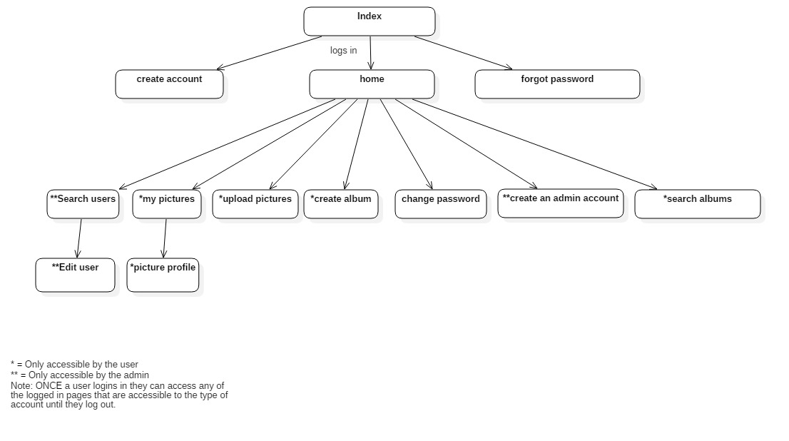
Site Map

Slide 6
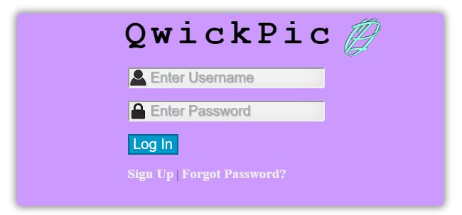
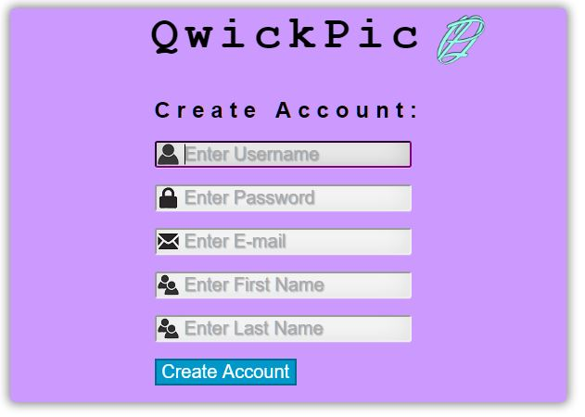

Login, Create Account and Forgot Password Pages

Slide 7
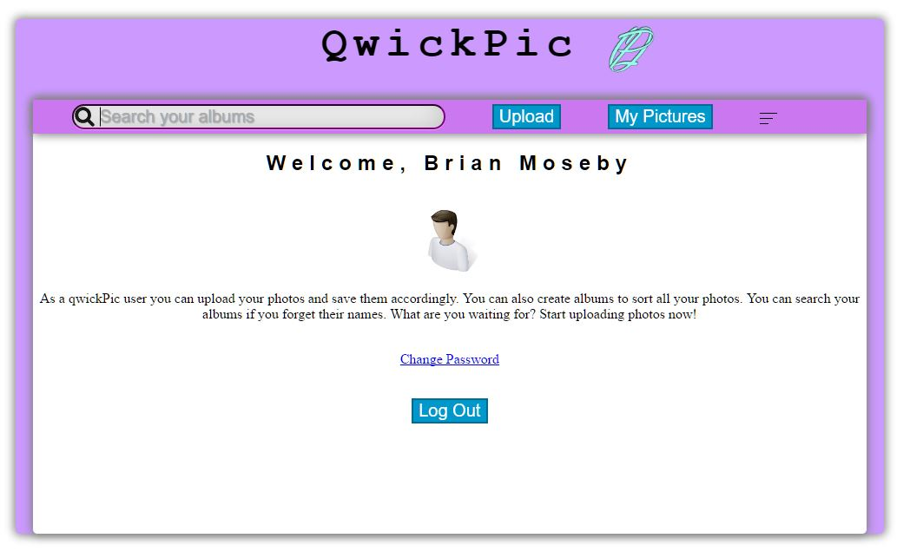
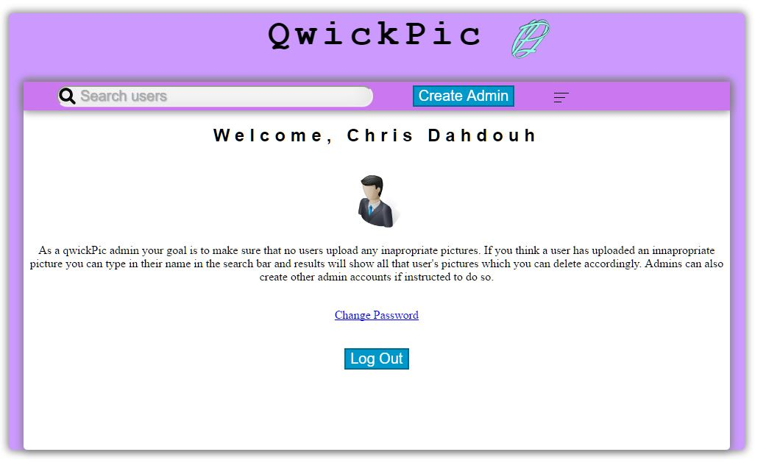
Landing Page: User vs Admin

Slide 8
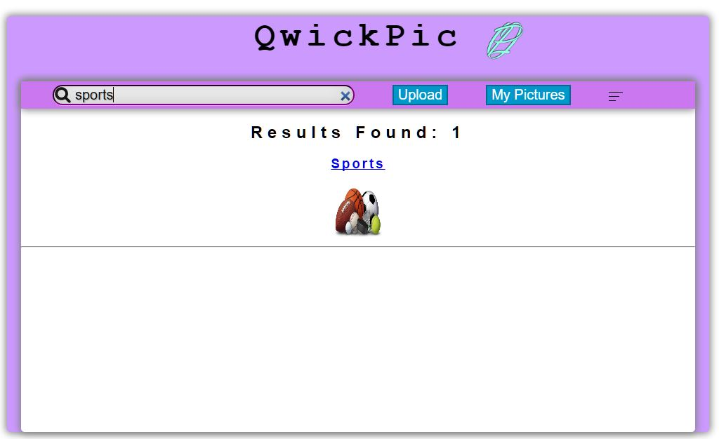
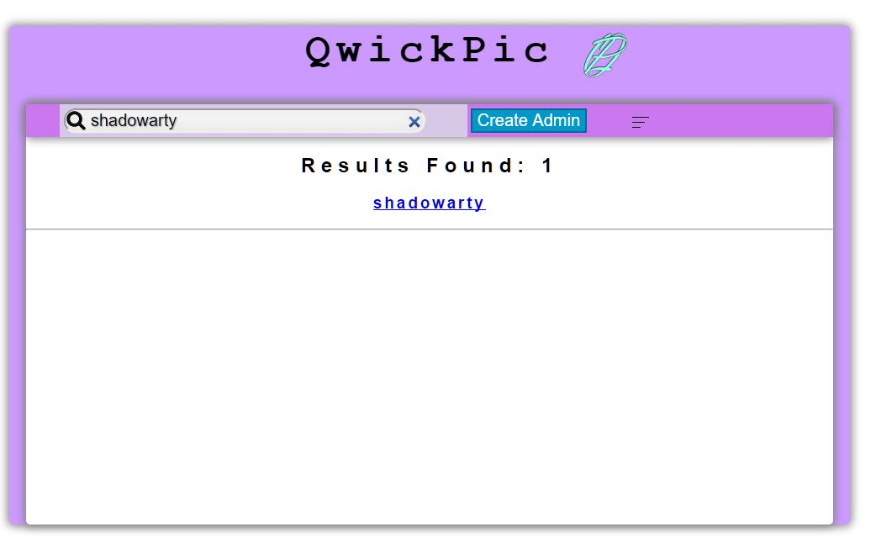
Search: User vs Admin

Slide 9
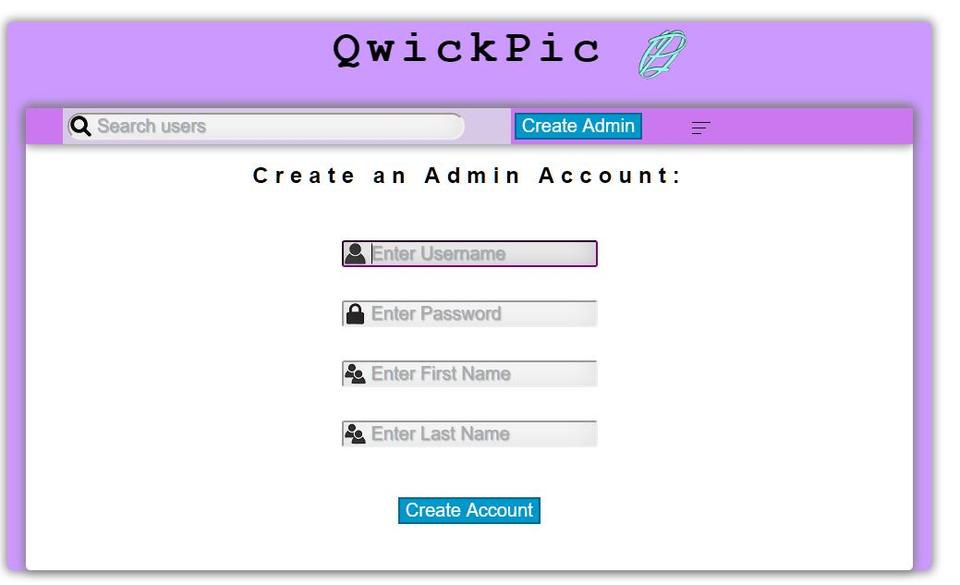
Admins can create Admin accounts

Slide 10
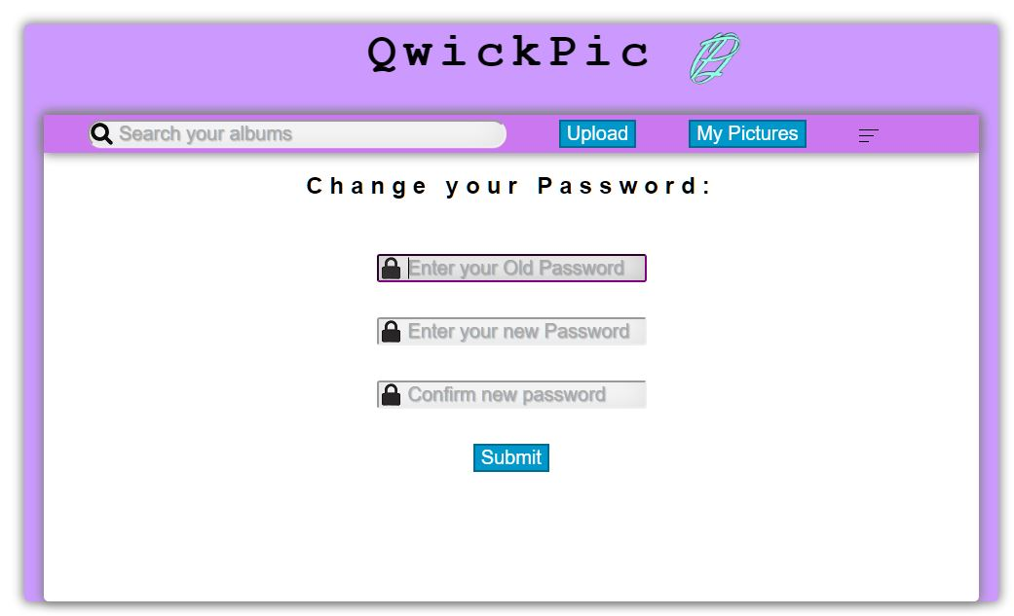
Change Password

Slide 11
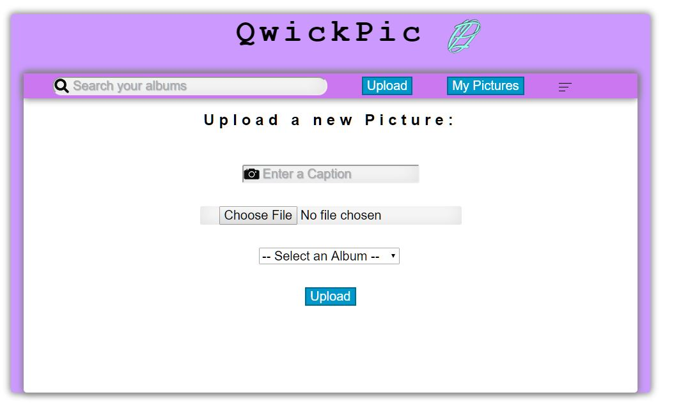
Upload new Pictures & albums

Slide 12
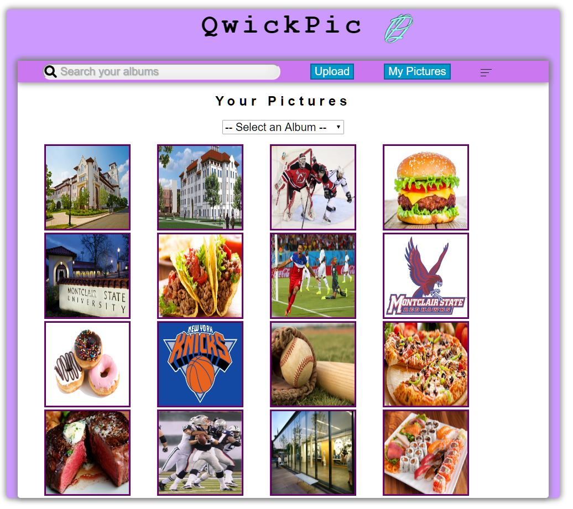
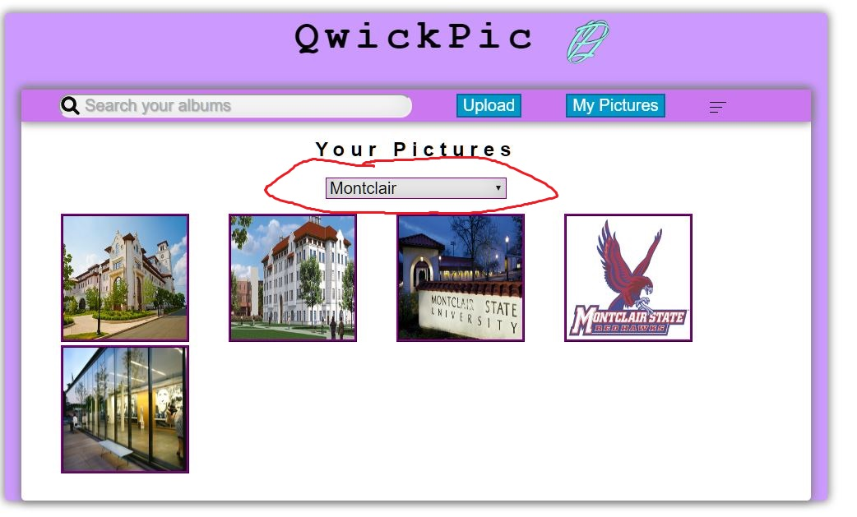
My Pictures

Slide 13
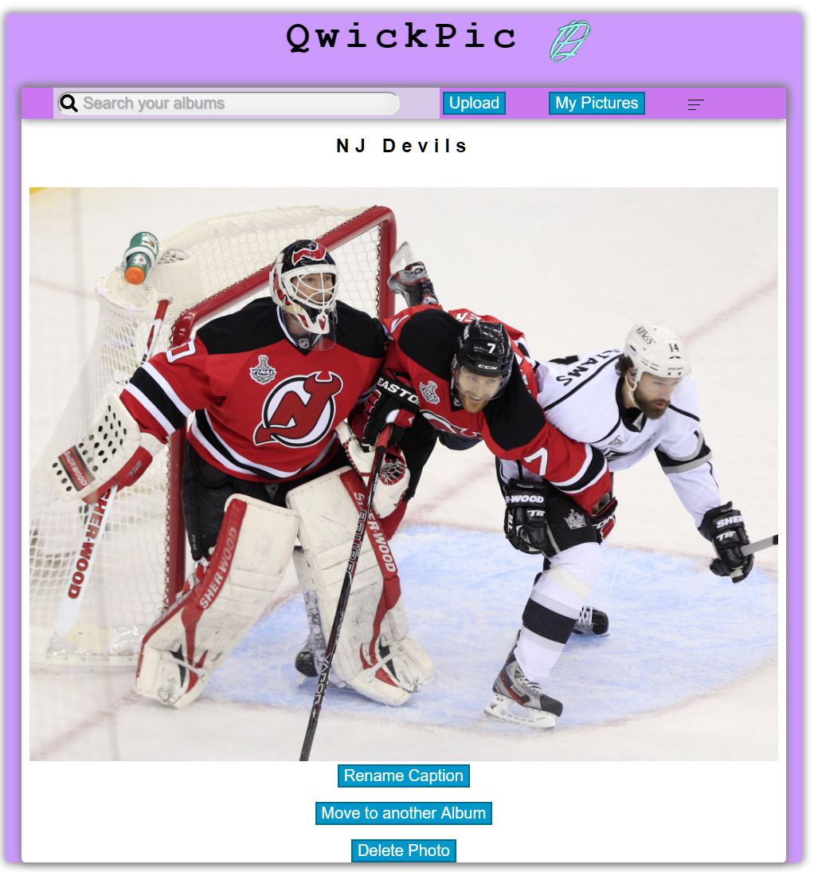
Picture Profile

Slide 14
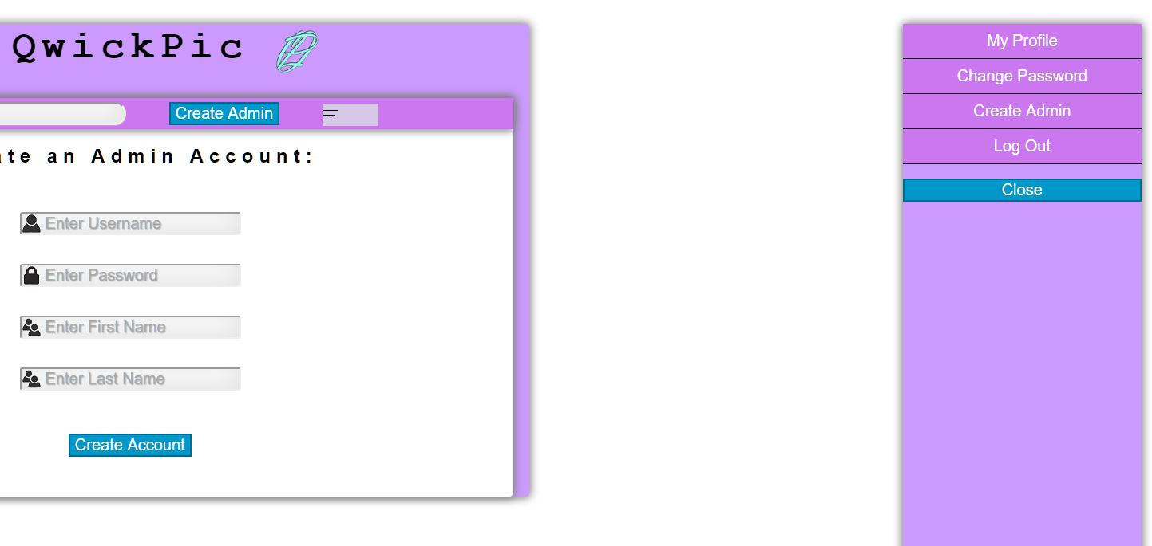
Sidebar

Slide 15
Questions?

